Slide 1
Payment Channels
Off-chain scaling

Slide 2
On-chain Transactions - Disadvantages
Speed
Privacy / Anonymity
Cost / Scale
Processing: 40,000 tx/s @ 250 B/tx (avg) = 10 MB/s = 80 Mb/s
Storing: 864,000 MB/day = 0.864 TB/day
40,000 ECDSA signatures/s is barely feasible

Slide 3
Off-chain Transactions
Movement of value outside of the blockchain
record the results on chain later
“Second layer technology” or “Layer 2 technology”
Bitcoin - lightning network
fast, secure, private, trustless, and permissionless payments (and cheap too)
Ethereum - raiden network
https://lightning.network/lightning-network-paper.pdf

Slide 4
Payment Channels
Second layer technology
Typically used for “micropayments” *
Channel forms financial relationship between two wallets
cryptographic communication protocol between channel partners
2-out-of-2 multisig address
Funding (opening) transaction on-chain, n transactions off-chain, settlement (closing) transaction on-chain
channel capacity: channel funded with x amount of bitcoin on opening transaction
2 public transactions, n private transactions
* https://bitcoin.stackexchange.com/questions/85650/htlcs-dont-work-for-micropayments/85694#85694

Slide 5
Commitment Transaction
Need to make sure channel participants able to get funds back in case the channel partner unresponsive/malicious
Alice creates pub/priv keys & informs Bob she wishes to open a channel
Bob creates pub/priv keys & sends Alice his pub key
Alice creates funding tx & sends seed funds to multisig addr -> 10 mBTC
cannot spend from multisig without sigs from Alice & Bob
Alice does not broadcast funding tx to network, but sends Bob tx id
Alice & Bob create commitment txs which spends from funding tx sending all currency to Alice -> 10 mBTC to Alice
Alice & Bob sign respective commitment txs
Alice broadcasts funding tx to network

Slide 6
Commitment Transaction
Alice now has ownership of channel’s balance & can get her funds back if Bob unresponsive
Must create new commitment tx any time balance changes
If Alice sends Bob 3 mBTC, her balance is now 7 mBTC
new commitment tx sends 7 mBTC to Alice, instead of original 10 mBTC
Need mechanism to invalidate previous commitment txs as new ones created

Slide 7
Timelock
Each channel partner encumbers own output with timelock and revocation secret
Timelock prevents owner of output to spend immediately once commitment tx included in a block
time measured by number of blocks
Within timelock window, anyone who knows full revocation secret can spend the output even before timelock expires
Alice and Bob each have half of the revocation secret
If Alice gives to Bob, Bob has full secret and can spend output
When updating channel balance, Alice gives Bob her half of the secret

Slide 8
Trustless Payment Channels
After publishing commitment tx, Alice can close channel if Bob doesn’t respond and claim back her funds, but has to wait for timelock to expire before spending the funds.
If Alice tries to publish an old commitment tx, she must wait for timelock, but Bob can immediately claim funds since he has the full revocation secret for that tx.
Bob gets full channel capacity, i.e. more than if Alice never tried to cheat.
Total fees are the on-chain opening (funding) tx and commitment tx, but none of the n payment channel txs.

Slide 9
P2P Gossip Protocol
How to transact with someone you’re not directly connected with?
Payment channels announced to network via gossip protocol
each node on network verifies funding transaction
each node forwards message to peers
Network topology shared through gossip
new nodes
new payment channels
payment channel updates
Topology information needed for delivering payments (routing) through payment channels

Slide 10
Routing
Nodes on network act as routers
Payments on network forwarded along a path of payment channels
Finding optimal path hard (unsolved) problem
incomplete network topology, by design
Onion routing used
like Tor
full path encrypted in layers
routing nodes only know who payment came from and who to forward to
Each node in path must have enough liquidity (capacity in channel)

Slide 11
HTLCs
Hashed Timelock Contracts
Hashlocks - restrict spending of funds locked in contract
Timelocks - act as fail-safe, timeout

Slide 12
HTLC protocol
Alice = sender, Bob = router, Carol = recipient
Alice asks Carol to create random pre-image, R
Carol creates hash: H = Hash( R )
Carol sends Alice H
Alice places hashlock between her and Bob, with some tx value + fee
unlocks when R is given -> transfers tx value + fee to Bob
neither knows R yet, but both know H
Alice places timelock
Alice refunded if / when timelock expires
Bob creates similar HTLC with Carol, same tx value
Carol unlocks Bob’s HTLC with R, gets tx value
Bob now knows R, unlocks Alice’s HTLC, gets tx value + fee

Slide 13
HTLC - trustless
What if Bob refuses to send Carol tx value?
Carol never gives out R
Bob cannot claim tx value + fee
Timelock expires
Alice re-claims tx value + fee

Slide 14
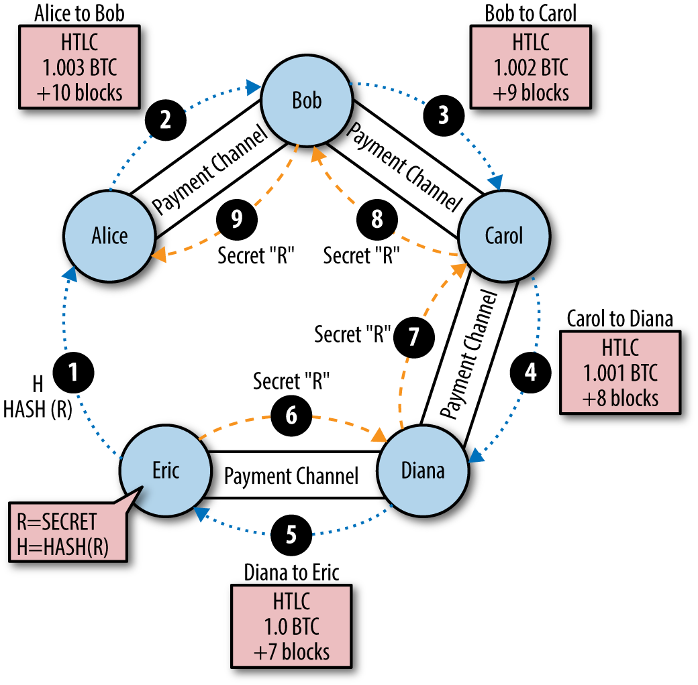

Slide 15
State Channels
Generalize notion of payment channels into state channels
Instead of supporting payments, support state updates
e.g. moves for a game of chess
only broadcast once game finished
State deposit: lock up some portion of blockchain state into multisig contract
to update the state, specific set of participants must agree with each other
Channel participants sign valid transactions without broadcasting them
each new transaction “trumps” previous updates
n amount of transactions can occur, all off-chain
Submit final state to blockchain, unlocking the state
usually the submitted state is in a new configuration
If the state being updated is digital currency balance -> payment channel
https://l4.ventures/papers/statechannels.pdf

Slide 16
Resources
Rusty Russell - Lightning Networks p1, p2
Mastering the Lightning Network (incomplete)
Blockchain for Developers: Bitcoin Scripts
Ethereum Raiden Network 101
HTLCs considered harmful
Visualizing HTLCs
State Channels
Counterfactual: Generalized state channels on Ethereum
Making sense of Ethereum's Layer 2 Scaling Solutions

